Slide 1
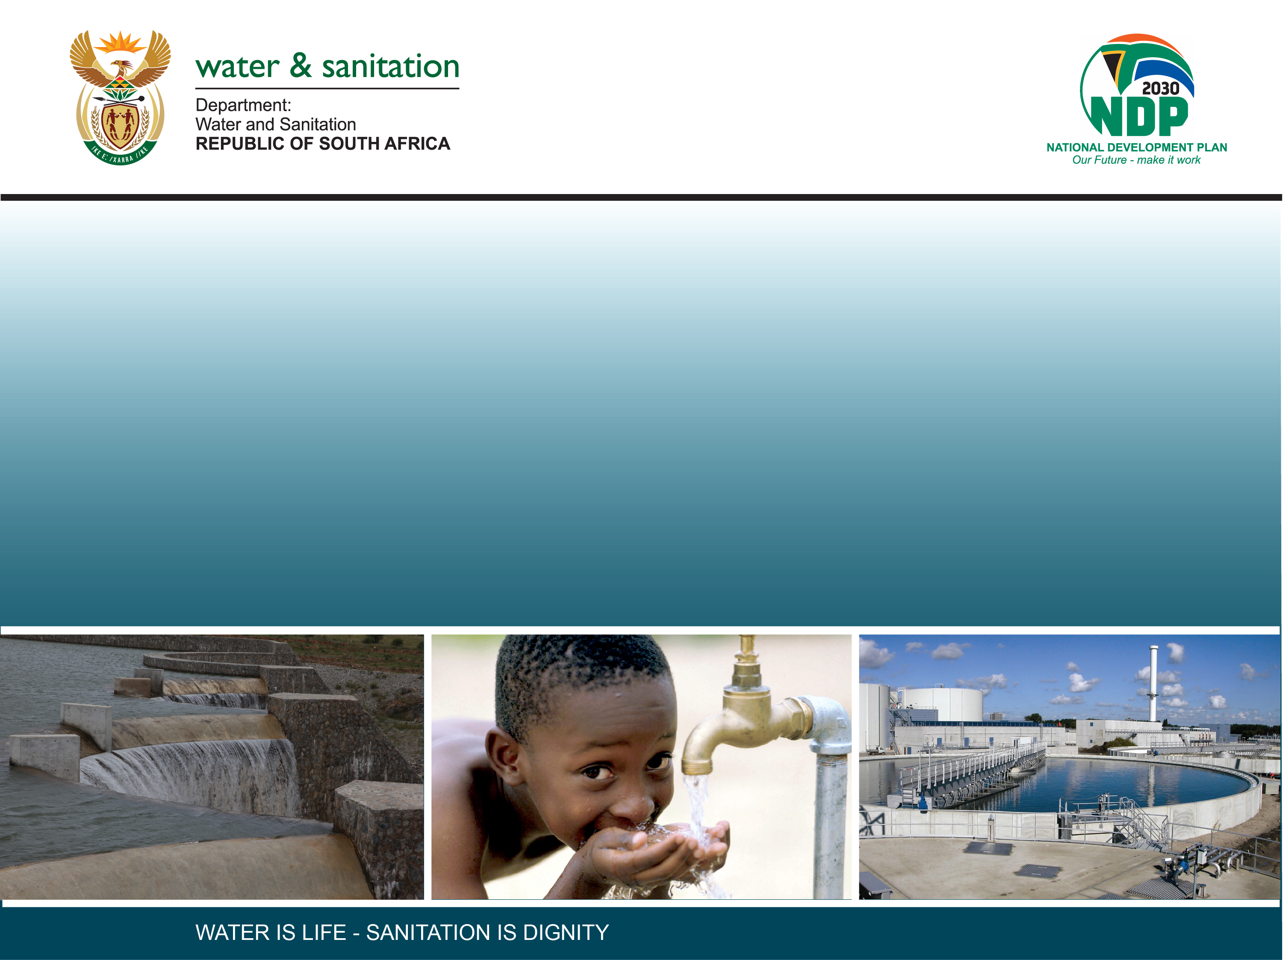
CLASSIFICATION OF SIGNIFICANT WATER RESOURCES AND DETERMINATION OF RESOURCE QUALITY OBJECTIVES FOR WATER RESOURCES IN THE USUTU TO MHLATHUZE CATCHMENTS (WP11387)
8.3 ESTUARY ECOLOGICAL CONSEQUENCES

Slide 2
ESTUARIES: PES, REC & EOLOGIAL CONSEQUENCES
Dr Lara van Niekerk

Slide 3
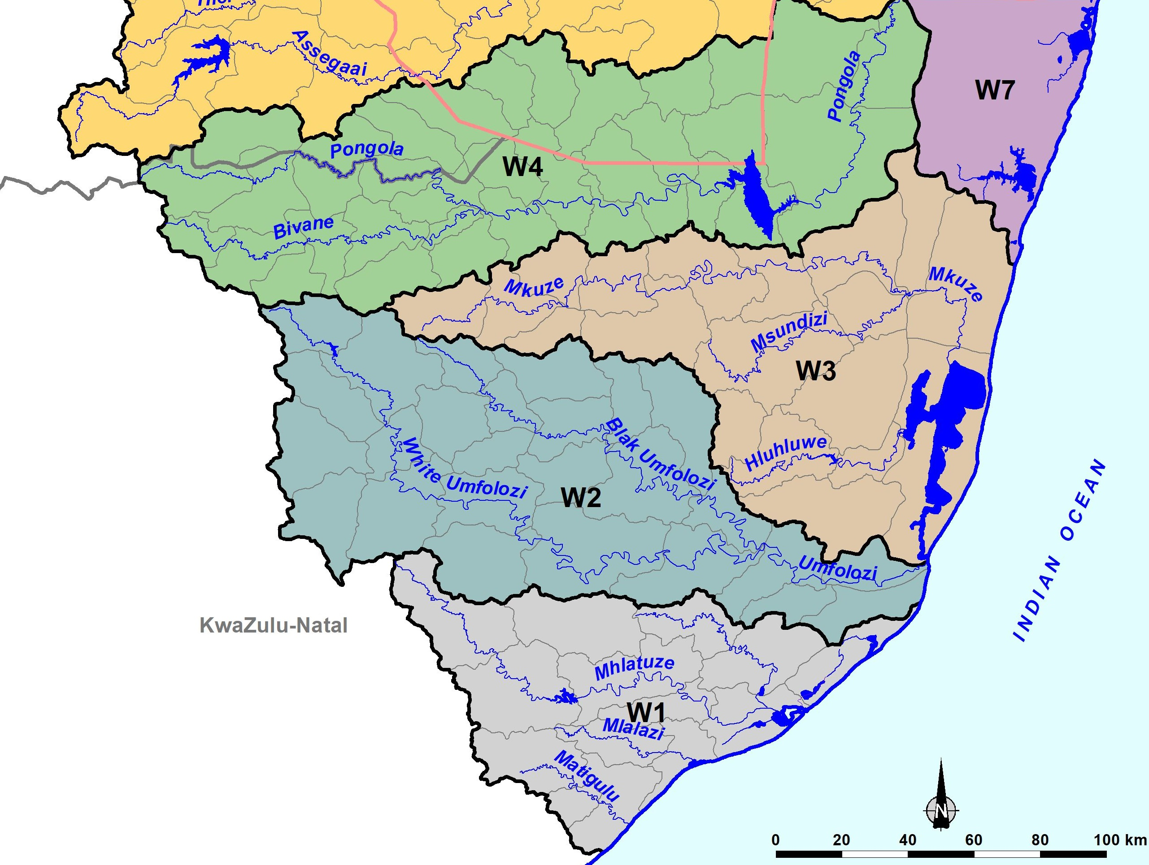
ESTUARIES WITH UPDATED PES & SCENARIO ASSESSMENT EVALUATION
Kosi
uMgobezeleni
iNhlabane
uMhlathuze
uMlalazi
iSiyaya
aMatigulu/iNyoni
Notes:
STAR= Estuaries visited during field trip
Could not access uMlatuze due to Transnet industrial strike – tried twice and replaced with field work on Matigulu & Mlalazi

Slide 4
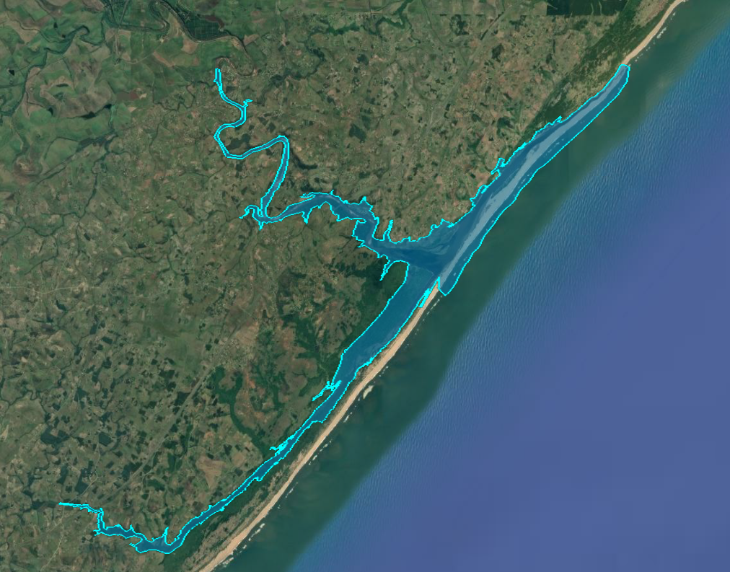
aMatigulu/iNyoni
Notes:
Not raising any red flags at this stage.

Slide 5
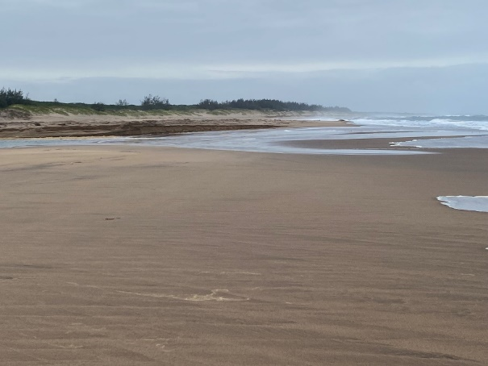
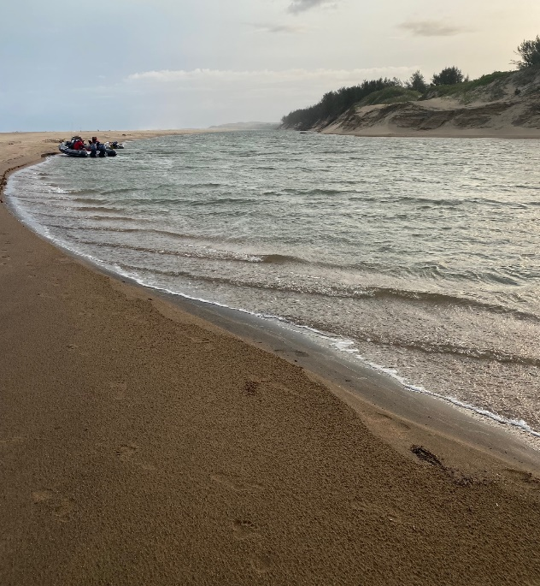
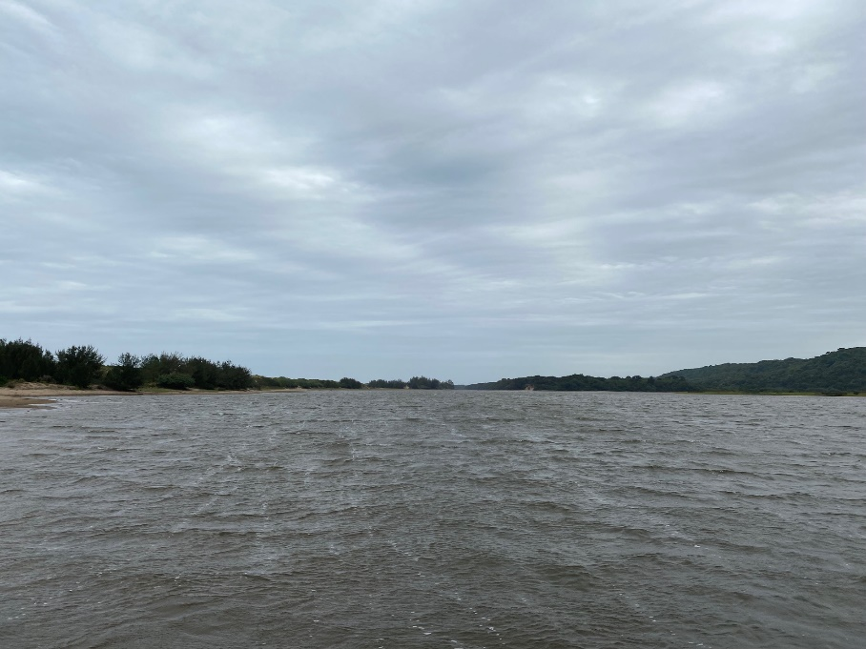
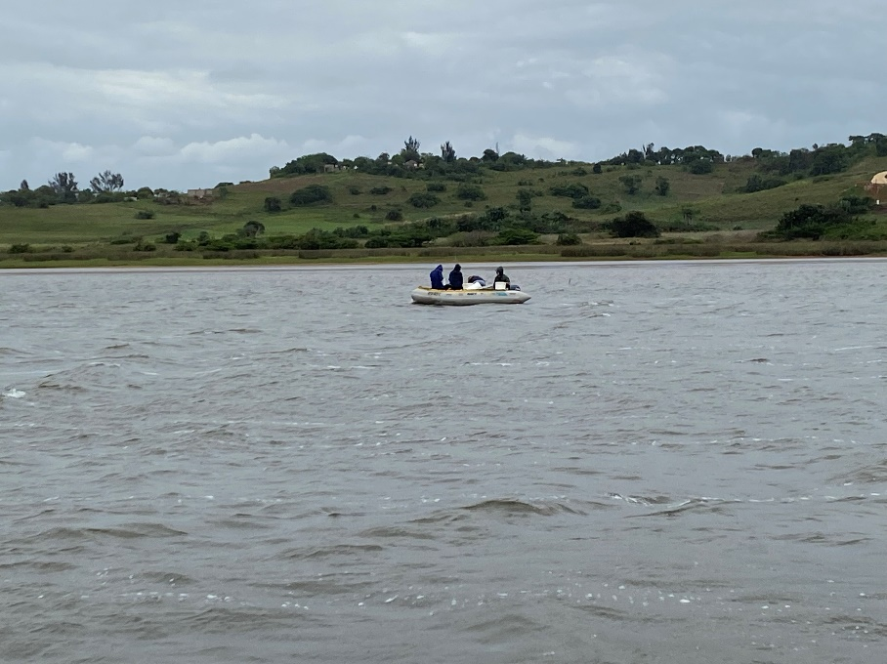
aMatigulu/iNyoni
Key Pressures:
Reduce flows (81% similar)
Declining water quality (agricultural return flow & diffuse sources)
Land-use change in the EFZ
Very high fishing pressure (illegal gillnetting)
Recreational disturbance of waterbirds
Notes:
Not raising any red flags at this stage.

Slide 6
aMatigulu/iNyoni
Component | PES
Hydrology | 73
Hydrodynamics and mouth condition | 84
Water quality | 63
Physical habitat alteration | 83
Habitat health score | 76
Microalgae | 79
Macrophytes | 78
Invertebrates | 70
Fish | 65
Birds | 70
Biotic health score | 72
ESTUARINE HEALTH SCORE | 74
PRESENT ECOLOGICAL STATUS | B/C
⬇ Flow reduction & Nutrient enrichment
Notes:
Not raising any red flags at this stage.

Slide 7
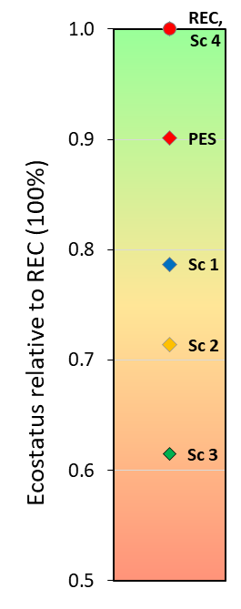
aMatigulu/iNyoni
PES: B/C
REC: B (Protected Area)
Recommended Scenario 4 …
Increase base flows
Improve water quality (agriculture return flow & diffuse sources)
Reduce fishing pressure (increase compliance)
Manage disturbance of birds
Manage land-use change around estuary
Notes:
Not raising any red flags at this stage.

Slide 8
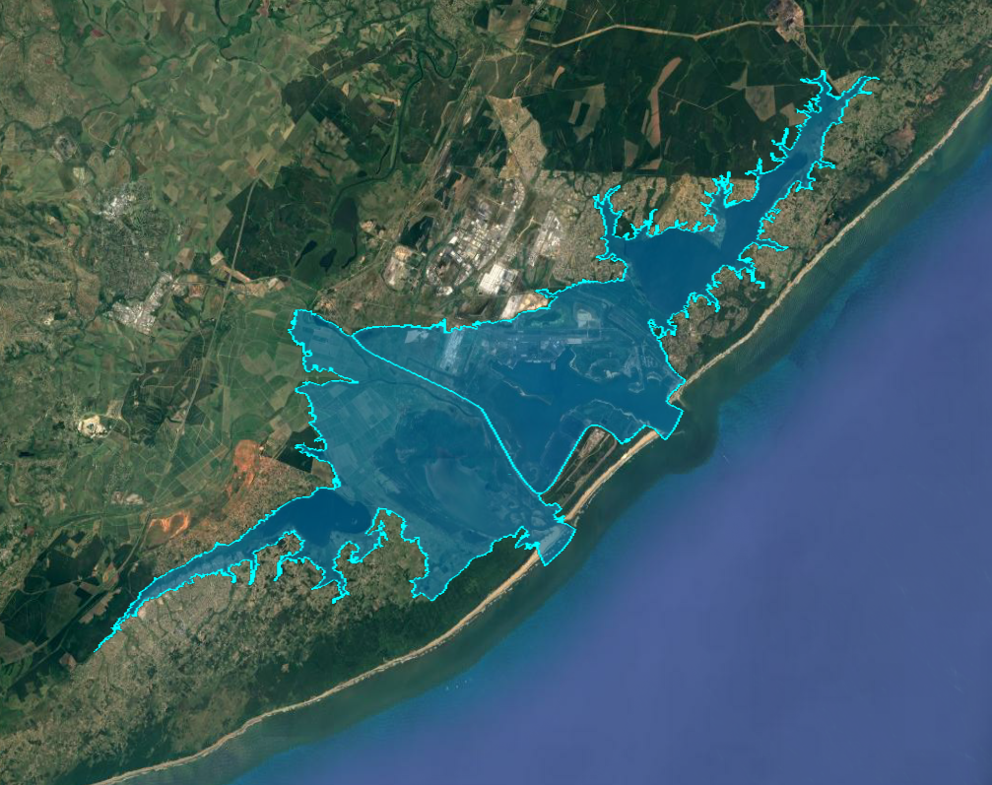
MHLATUZE
Notes:
Mangroves – ‘lolly pop’ trees as a result of over harvesting of side branches of mangroves

Slide 9
MHLATUZE
Key pressures
Historical port development (separate mouth)
Land-use change in EFZ (port & agriculture)
Very high fishing pressure
River and lakes water quality (agriculture & diffuse runoff)
Flow reduction
Loss of connectivity between part of the system (Lakes Mzingazi & Chubu, estuary and Richards Bay Port/Harbour)

Slide 10
MHLATUZE
 | PES
uMhlatuze | Lake Mzingazi | Richards Bay | uMhlatuze | Lake Chubu
Hydrology | 53 | 53 | 53 | 53
Hydrodynamics and mouth condition | 10 | 18 | 39 | 10
Water quality | 71 | 45 | 57 | 58
Physical habitat alteration | 10 | 20 | 50 | 10
Habitat health score | 36 | 34 | 50 | 33
Microalgae | 31 | 41 | 55 | 30
Macrophytes | 30 | 30 | 40 | 30
Invertebrates | 55 | 15 | 20 | 50
Fish | 25 | 25 | 40 | 35
Birds | 70 | 20 | 60 | 70
Biotic health score | 42 | 26 | 43 | 43
ESTUARINE HEALTH SCORE | 39 | 30 | 46 | 38
PRESENT ECOLOGICAL STATUS | D/E | E | D | E
Notes:
Mangroves – ‘lolly pop’ trees as a result of over harvesting of side branches of mangroves

Slide 11
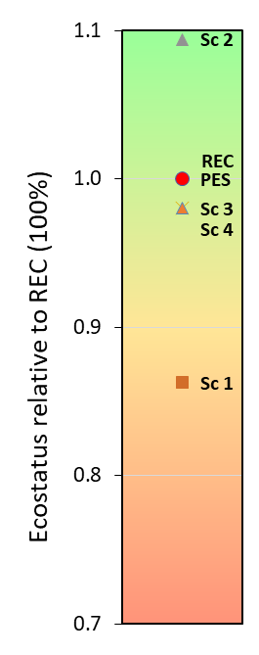
MHLATUZE
PES: D
REC: D (Protected Area)
Recommended scenario: Any development scenarios as tide mitigates
Increase connectivity between lakes & estuary - functional fishways
Reduce fishing pressure (compliance)
Improve access to allow for compliance, monitoring and research
Bird Tourism – livelihood opportunity
R Bay: Port Restoration Initiative (Blue carbon & nursery function)
Improve water quality (agricultural & diffuse runoff)
Notes:
Short term
Increase connectivity between lakes and down stream waters should be improved by functional fishways
Long-term
Port must start an initiative to retain and restore estuarine function.
Blue Carbon are valuable habitat. Credit to protect this habitat. Port off set their carbon footprint Zostra: Protect areas were reinstalment is occurring, Reestablish near yacht teminal. Look for bio enhancement opportunities in support of nursery.
Improve access to system to allow for compliance, monitoring and research. No oversight - thus no awareness
Opportunities for bird tourism if access was improved. Could provide livelihoods in stead of illegal activities. Spin off for accommodation. BirdLife SA could assist with training off guides - Zululand birding route.
Improve research to understand change

Slide 12
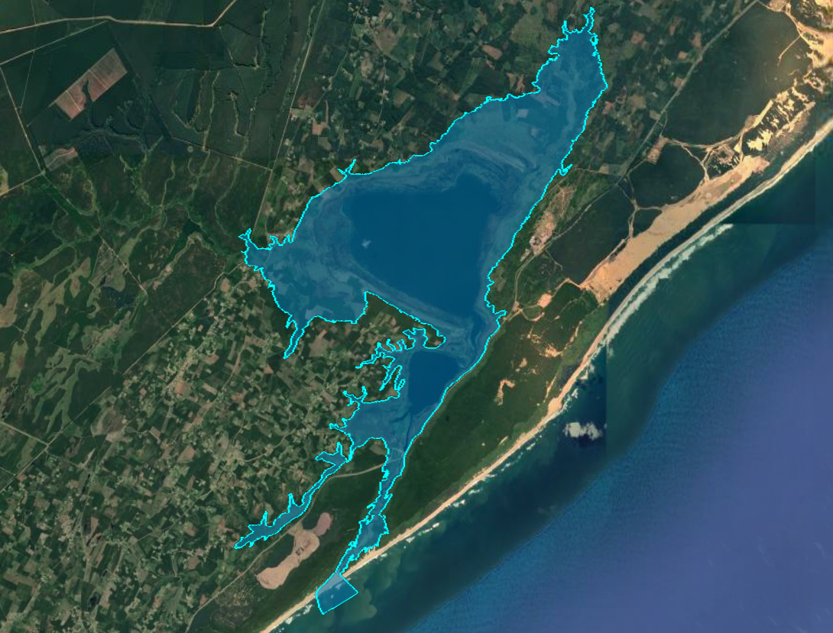
iNhlabane

Slide 13
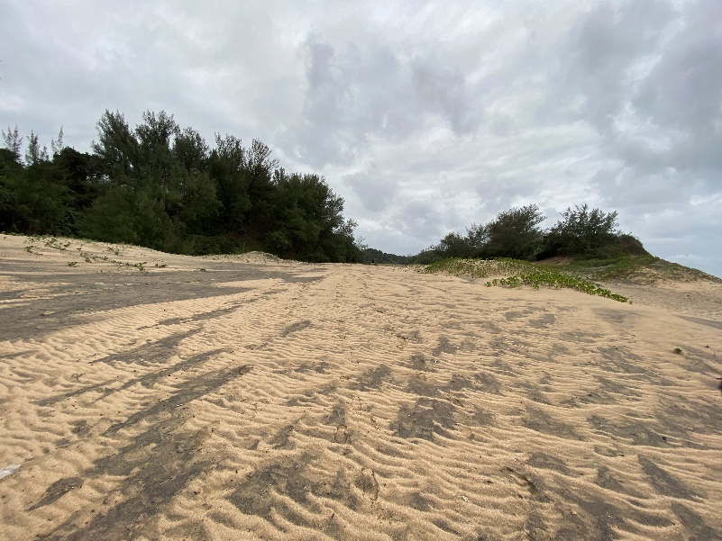
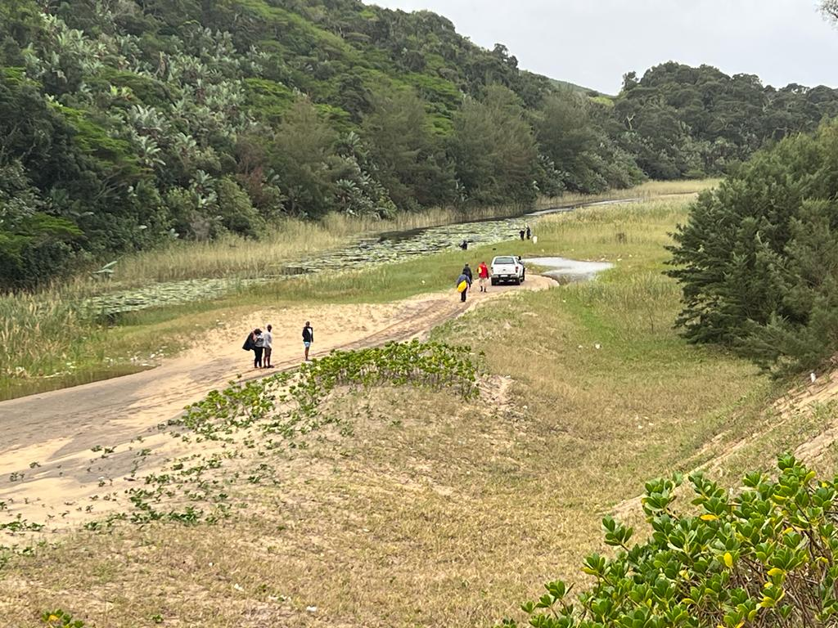
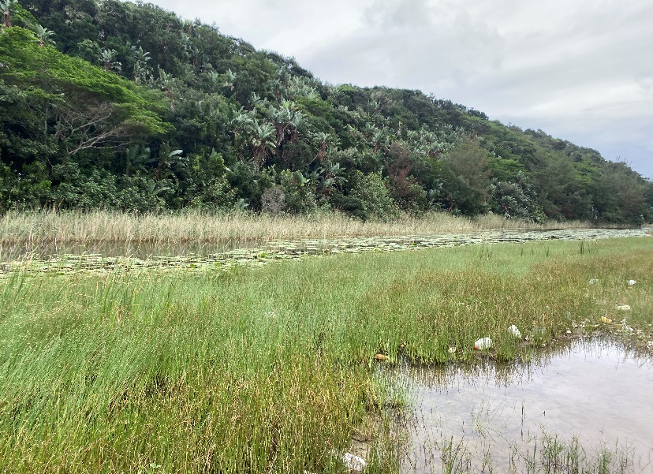
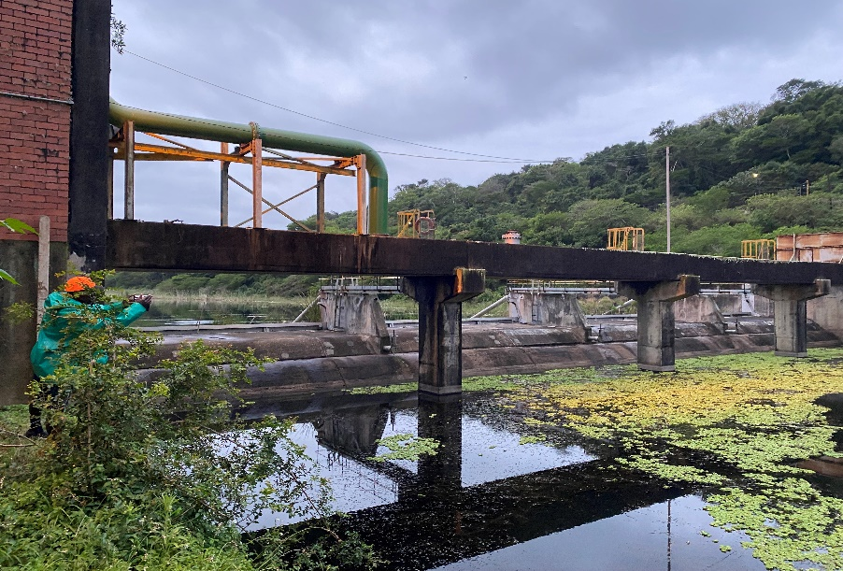
iNhlabane
Key Pressures:
No flow to estuary – no EWR releases & no functional fishway
Physical habit alteration (build up of sediment)
Build up of organic matter in estuary (forming a sludge)
Poor water quality (pollution and in situ remineralization)
No connectivity with lakes
Bilharzia snail vectors & alien invasive Terebia granifera snails
No estuarine functionality remain in what was once an important estuarine lake in the region, due to freshwater flow depravation

Slide 14
iNhlabane
 | PES
Component | Estuary | North & South Lakes
Hydrology | 33 | 75
Hydrodynamics and mouth condition | 59 | 29
Water quality | 32 | 25
Physical habitat alteration | 30 | 10
Habitat health score | 39 | 35
Microalgae | 31 | 56
Macrophytes | 50 | 20
Invertebrates | 10 | 15
Fish | 5 | 15
Birds | 20 | 30
Biotic health score | 23 | 27
ESTUARINE HEALTH SCORE | 31 | 31
PRESENT ECOLOGICAL STATUS | E | E
Notes:
No flow over the Nhlabane barrage - EWR not released in years
Fishway non-functional - Only 3 fish species recorded, all freshwater taxa tolerant of poor water quality.
Extensive loss of open water area due to macrophyte growth
System was fresh - leaches, water lilies and tadpoles

Slide 15
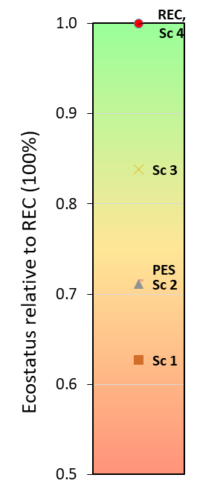
iNhlabane
PES: E
REC: D (Nature Reserve)
Recommended Sc 4 (Sc 3 + Non-flow interventions)
Increase base flows (⬆ connectivity)
Mouth Management Plan – artificial breach mouth
Dredging of organic plant matter(sludge)
Prevent disturbance of riparian vegetation, trampling, cattle, fire, remove alien plants
Ensure connectivity – fishway (reengineering & releases)
Increase compliance (fishing)
Manage future development (EFZ & Lakes)
Notes:
Estuary:
Mouth Management Plan
Removal of sludge (an additional benefit)
Prevent disturbance of riparian vegetation, trampling, cattle, fire, remove alien plants
Lakes:
Control/reduce fishing effort
Varible lake levels will benefit water birds
Ensure connectivity, Draw down levels should not separate North and South Lake (find MSL level)
Fishways are not functional - we need to increase connectivity by flow release and possible reengineering of fishway
Proactive strategic planning is need to reduce impact of future developments - for example disposal of waste is a key issues. Waste can not run into estuary and lakes. Look into innovative ways to manage waste water in this area, e.g. artificial reed beds
Prevent disturbance of riparian vegetation, trampling, cattle, fire, remove alien plants Increase runoff through management/removal of wood lots (need an study to very and plan for this impact)

Slide 16
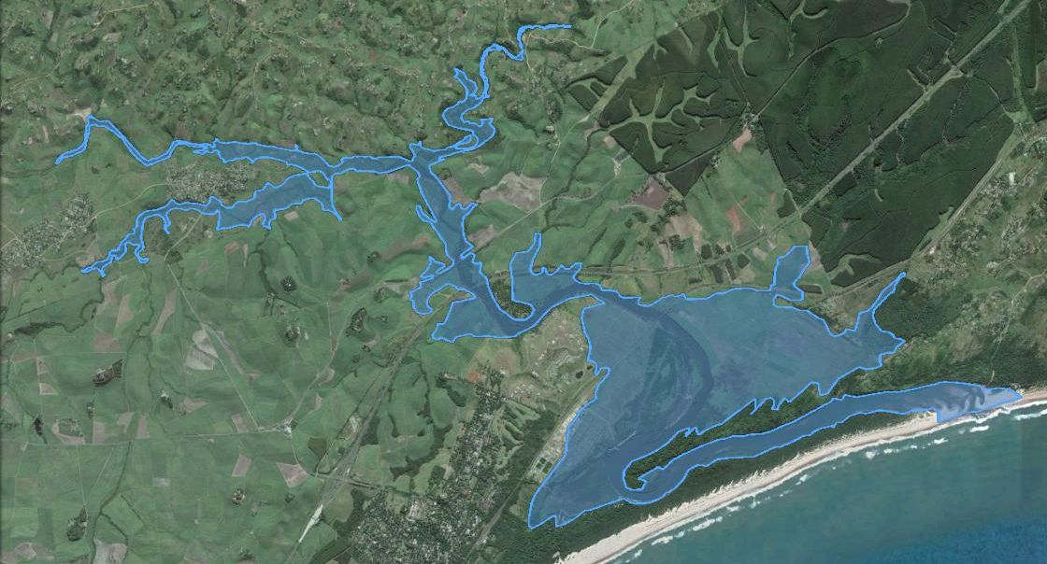
uMlalazi
Notes:
No waste water into this system as it will compromise it during lower flow periods

Slide 17
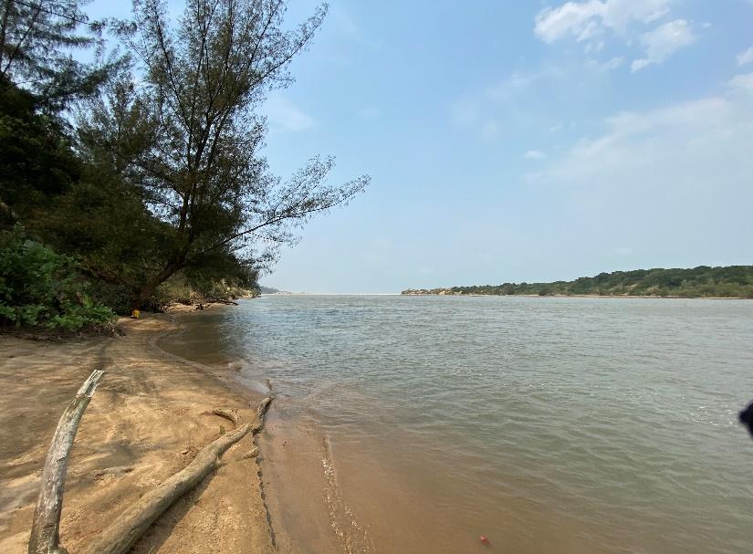
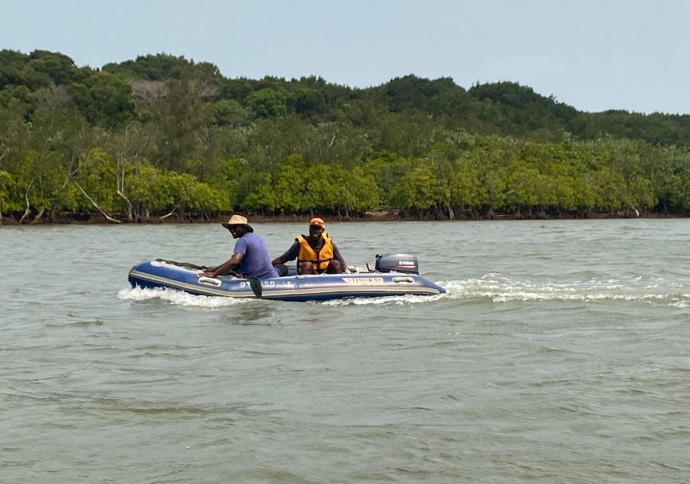
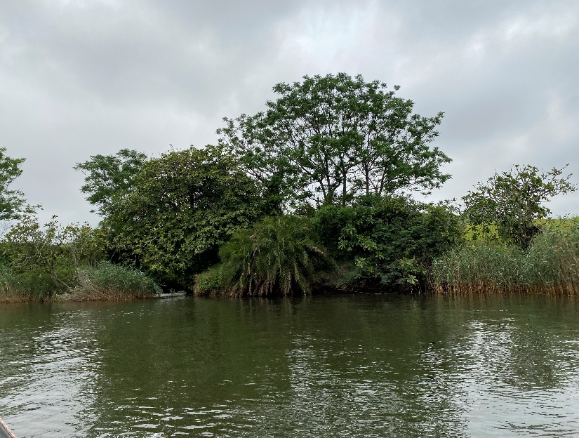
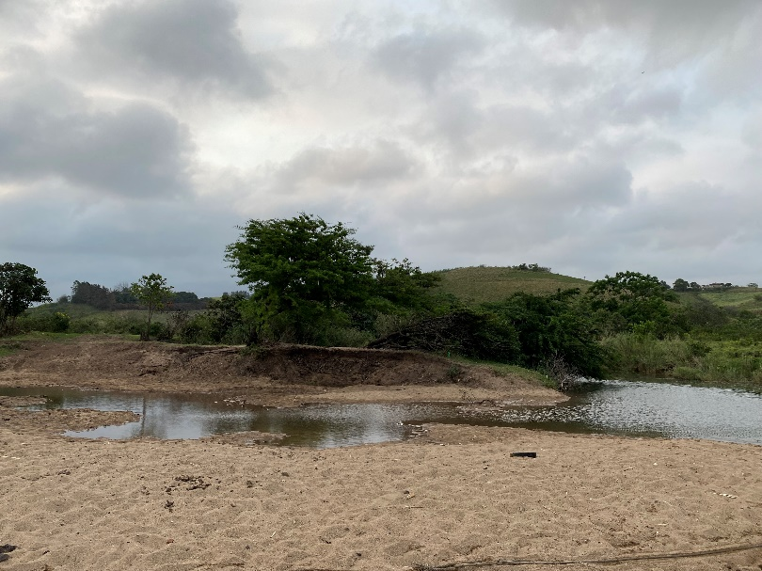
uMlalazi
Key Pressures:
Flow reduction (baseflows causing mouth closure)
Declining water quality (agriculture & diffuse runoff)
Land-use change and hard structures in the EFZ
Very high fishing pressure
Disturbance of birds (beach driving)
Burning of mangroves
Sand mining an emerging concern…
Will be very important to maintain its present baseflows (prevent mouth closure) & water quality state (no low oxygen levels) to ensure functionality and ecosystem services.
Notes:
No waste water into this system as it will compromise it during lower flow periods

Slide 18
uMlalazi
Component scores | PES
Hydrology | 72
Hydrodynamics and mouth condition | 84
Water quality | 66
Physical habitat alteration | 85
Habitat health score | 77
Microalgae | 72
Macrophytes | 70
Invertebrates | 75
Fish | 80
Birds | 60
Biotic health score | 71
ESTUARINE HEALTH SCORE | 74
PRESENT ECOLOGICAL STATUS | B/C
⬇ Flow reduction & Nutrient enrichment
Notes:
No waste water into this system as it will compromise it during lower flow periods

Slide 19
uMlalazi
PES: B/C
REC: B (Protected Area)
Recommended Scenario 9 (refining some baseflows + Non-flow interventions)
No wastewater (Sc 8)!!
Reduce fishing pressure (compliance)
Improve water quality (closed state) – agricultural & diffuse runoff
Restore/protect mangroves (fires)
Remove hard structures of aquaculture farm & investigate opportunities to rewild banks
Remove sand mining
Manage bird disturbance (car access)
Realign the PA delineation with the EFZ
Notes:
No waste water into this system as it will compromise it
Reduce extractive fishing effort (gill nets)
Strategic Planning and management of land-use in and around the EFZ: Limit industrial scale agriculture change to residential development
Big threat to Mlalazi: WQ already stressed especially a risk in the closed state –
no Waste Water dischage (recycle), implement agricultural best practise.
Also diffuse runoff from housing not on riticulation.
Monitor and Control sand-mining Increase base flows
Develop a plan to management disturbance to birds (e.g. closed areas, boating controls such as speed zones)
Control and manage verchile access at the mouth as a disturbance to birds
Prevent fires in mangrove area
Remove hard structures of pond farm & investigate opportunities to rewild banks and restoring gentle slopes where possible
Maintain hydrological connectivity (roads)
Realign the PA delineation with the EFZ to increase protection
during lower flow periods

Slide 20
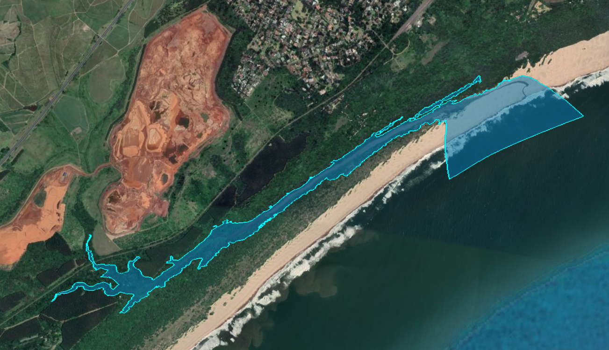
iSiyaya

Slide 21
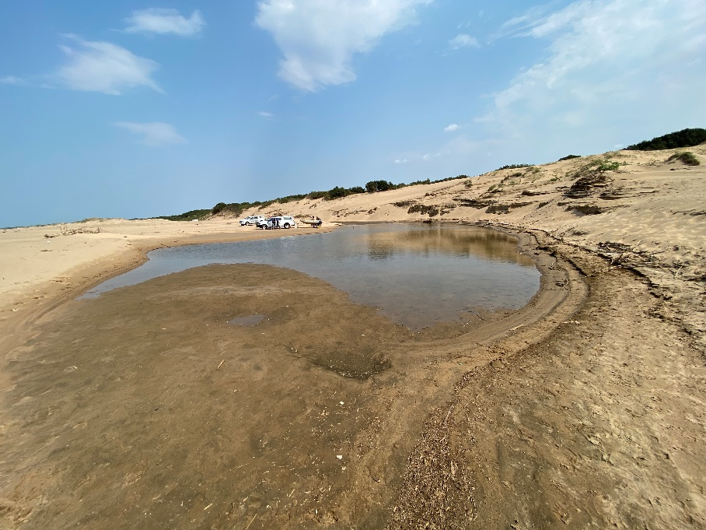
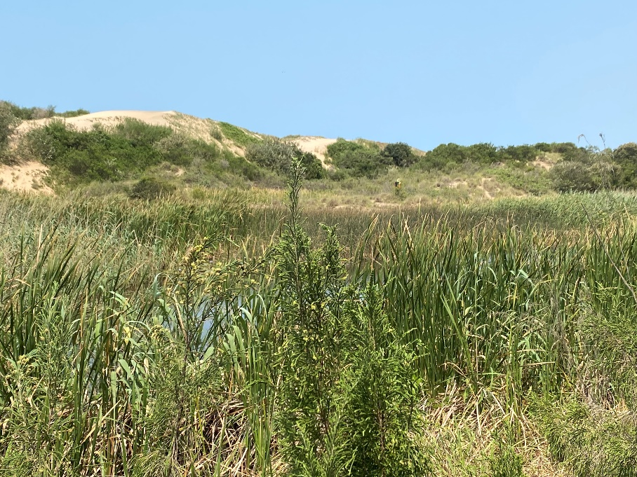
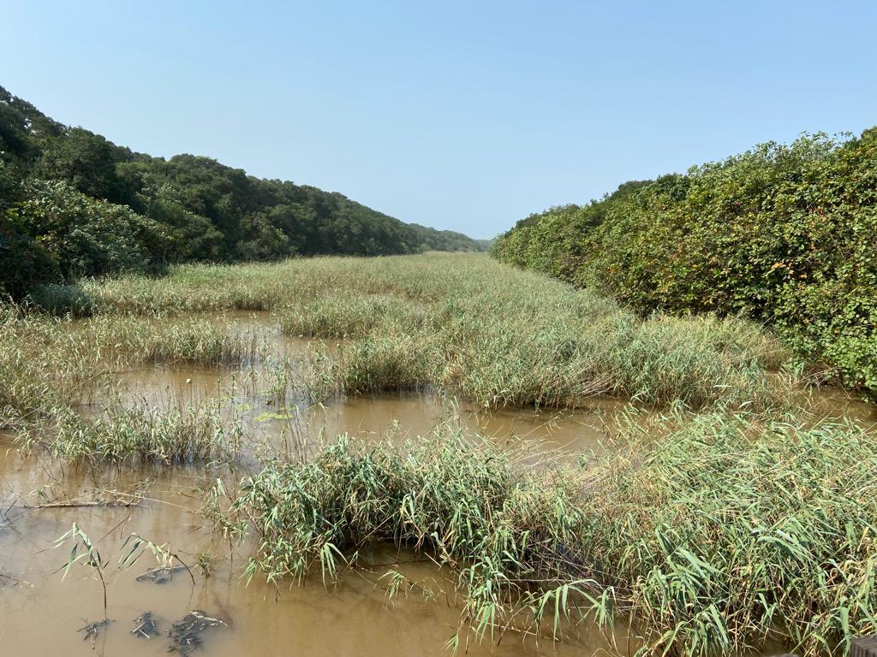
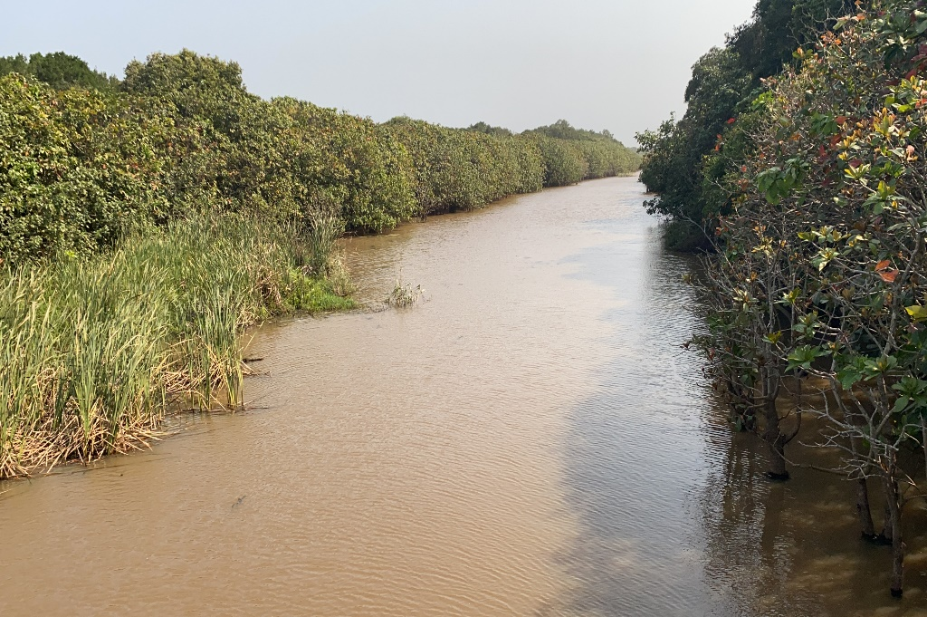
iSiyaya
Key pressures:
Flow reduction (abstraction & forestry)
Poor water quality
Impact of mining - very high turbidity in middle & upper reaches.
Loss of habitat
Direct disturbance

Slide 22
iSiyaya
Component | Present
Hydrology | 74
Hydrodynamics and mouth condition | 57
Water quality | 53
Physical habitat alteration | 30
Habitat health score | 53
Microalgae | 51
Macrophytes | 30
Invertebrates | 15
Fish | 15
Birds | 50
Biotic health score | 32
ESTUARINE HEALTH SCORE | 43
PRESENT ECOLOGICAL STATUS | D/E
Estuary changes into a stagnant swamp
Loss of estuarine community where once there was a thriving and rich community present
Human health risk - lung fluke risk associated with invasive species
Notes:
Complete state change of invertebrates as the estuary changed to a stagnant swamp. Near complete loss of estuarine community where once there was a thriving and rich community present
Middle and upper section - human health risk - Lung fluke risk associated with invasive species the state change

Slide 23
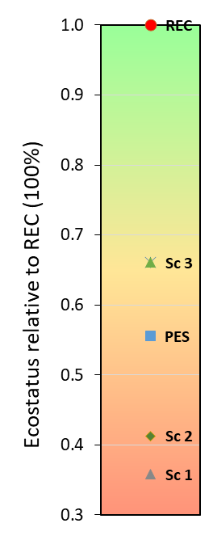
iSiyaya
PES: D/E
REC: C (Protected Area)
Recommended Scenario 3 + non-flow interventions
Ecosystems-based restoration project:
  Increase base flows
  Improve water quality (Catchment to Coast approach)
  Mitigate mining impacts (turbidity & sediment)
  Reduce impact forestry (buffer around EFZ & long-term reduction)
  Pioneer different footpath further N to beach
  Increase fishing compliance
Notes:
Ecosystem based adaptation restoration project to restore estuary functionality
Mechanical Intervention: Scenario 1 is flow scenario
Catchment to coast approach to reduce impact of poor water quality
Reduce impact of forestry (Buffer zones around estuary, long-term reduction in forested areas)
Mitigate for impacts of mining (reduce turbidity signal in runoff, sediment input)
Pioneer different footpaths to the beach further north
Increase fishing compliance (will escalate if fish communities recover)
Restore upstream riparian zone & remove alien vegetation

Slide 24
St Lucia/Mfolozi
PES: Fluctuate between E or D
REC: B (DWS 2016 & Ministerial Panel)
No new work as there was no new investment in monitoring & survey data (funds in the process of being secured)
Previous studies found total present flow from both the Mfolozi and St Lucia rivers are needed to achieve C
No recommended flow scenario – but state minimum recommend flows for B Category
  Cap minimum discharge in the Mfolozi at 3 m³/s to maintain an open mouth
  Combine Mfolozi/Mkuze drought discharge of 5 m³/s (including an additional 1.6 m³/s in Mkuze).
Improve water quality (Mkuze), reduce land-use change pressure, reduce fishing pressure, artificial breaching???
* Lake St Lucia Intermediate EWR Assessment Report (DWS 2016)
Notes:
The main DWS 2016 EWR report clearly states that the total present flow from both the Mfolozi and the St Lucia rivers are needed to achieve the C category, i.e. any flow scenario that would involve flow reduction from Present will not meet the REC. Less than 1% change can be made to Mfolozi flows, but that flow needs to be reallocated to the EWR of the St Lucia Rivers to ensure that the system remain in a C category (and not decline during droughts).

Slide 25
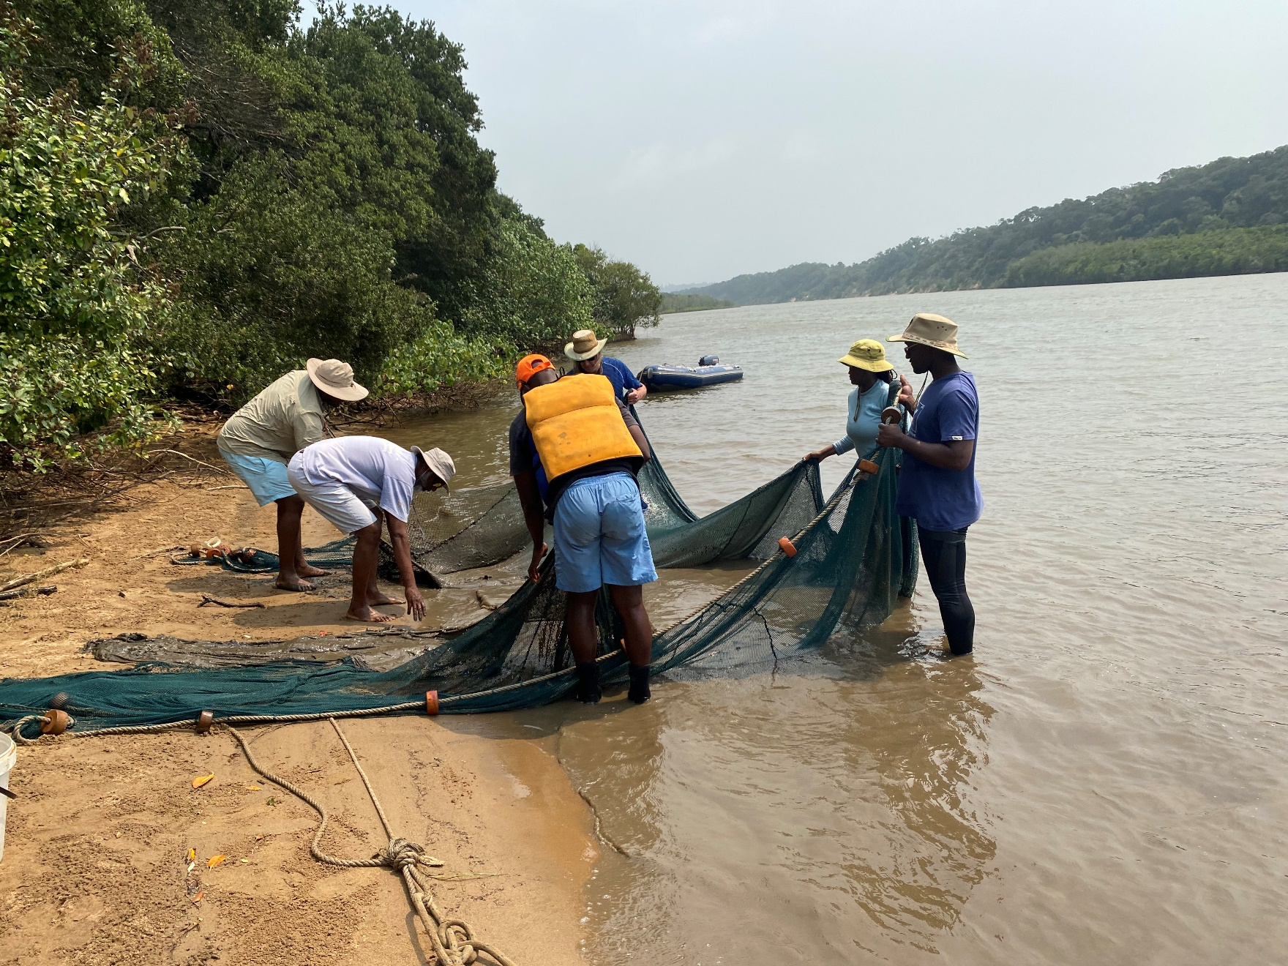
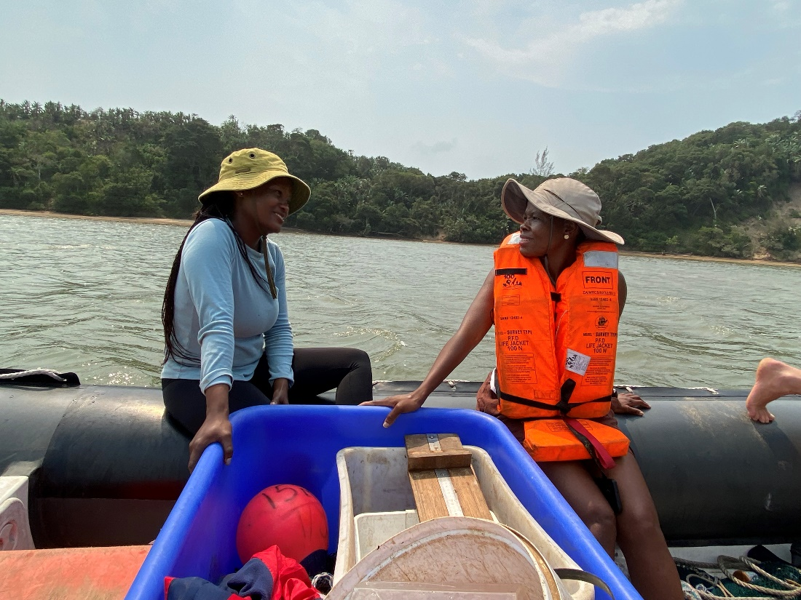
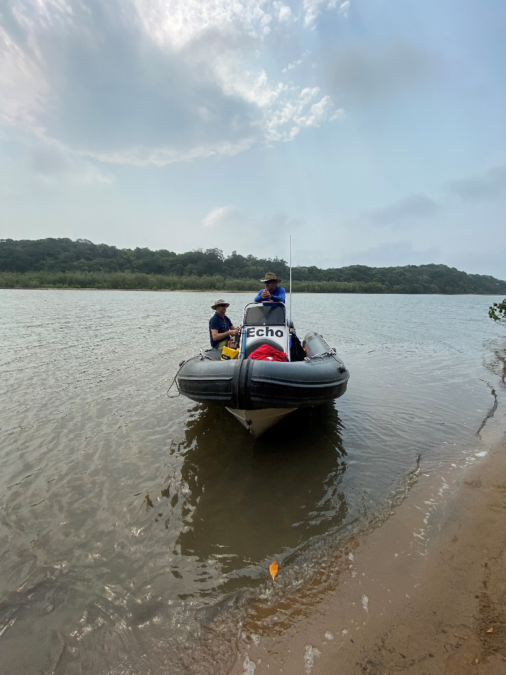
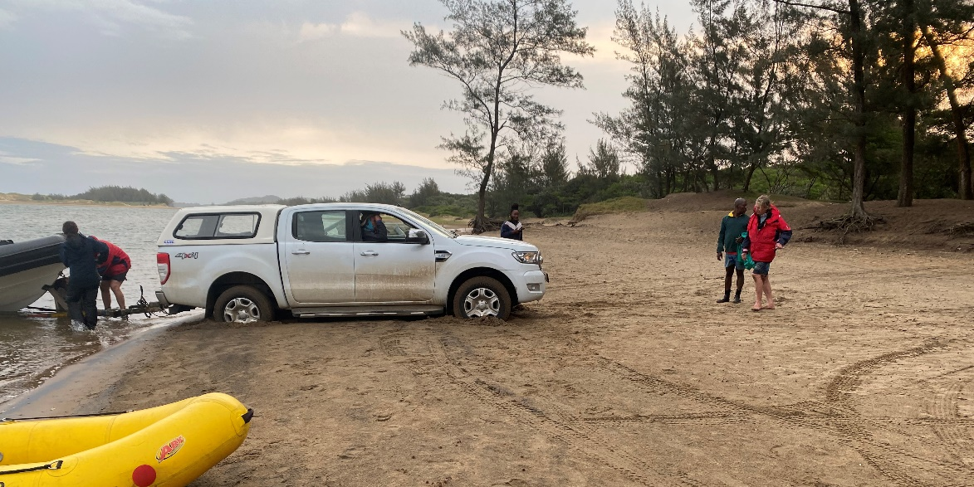
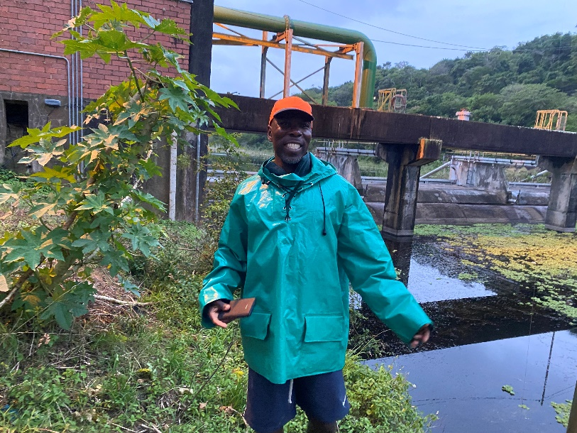
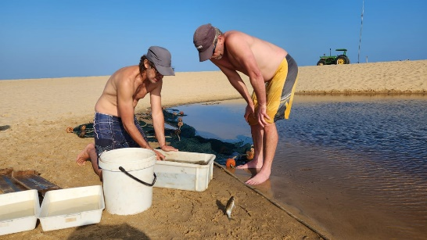
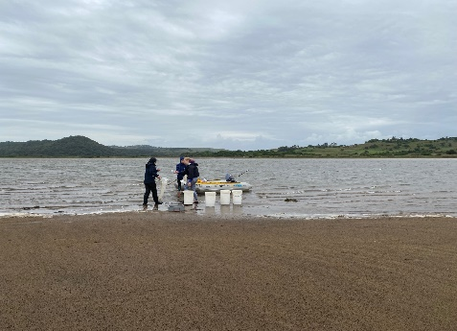
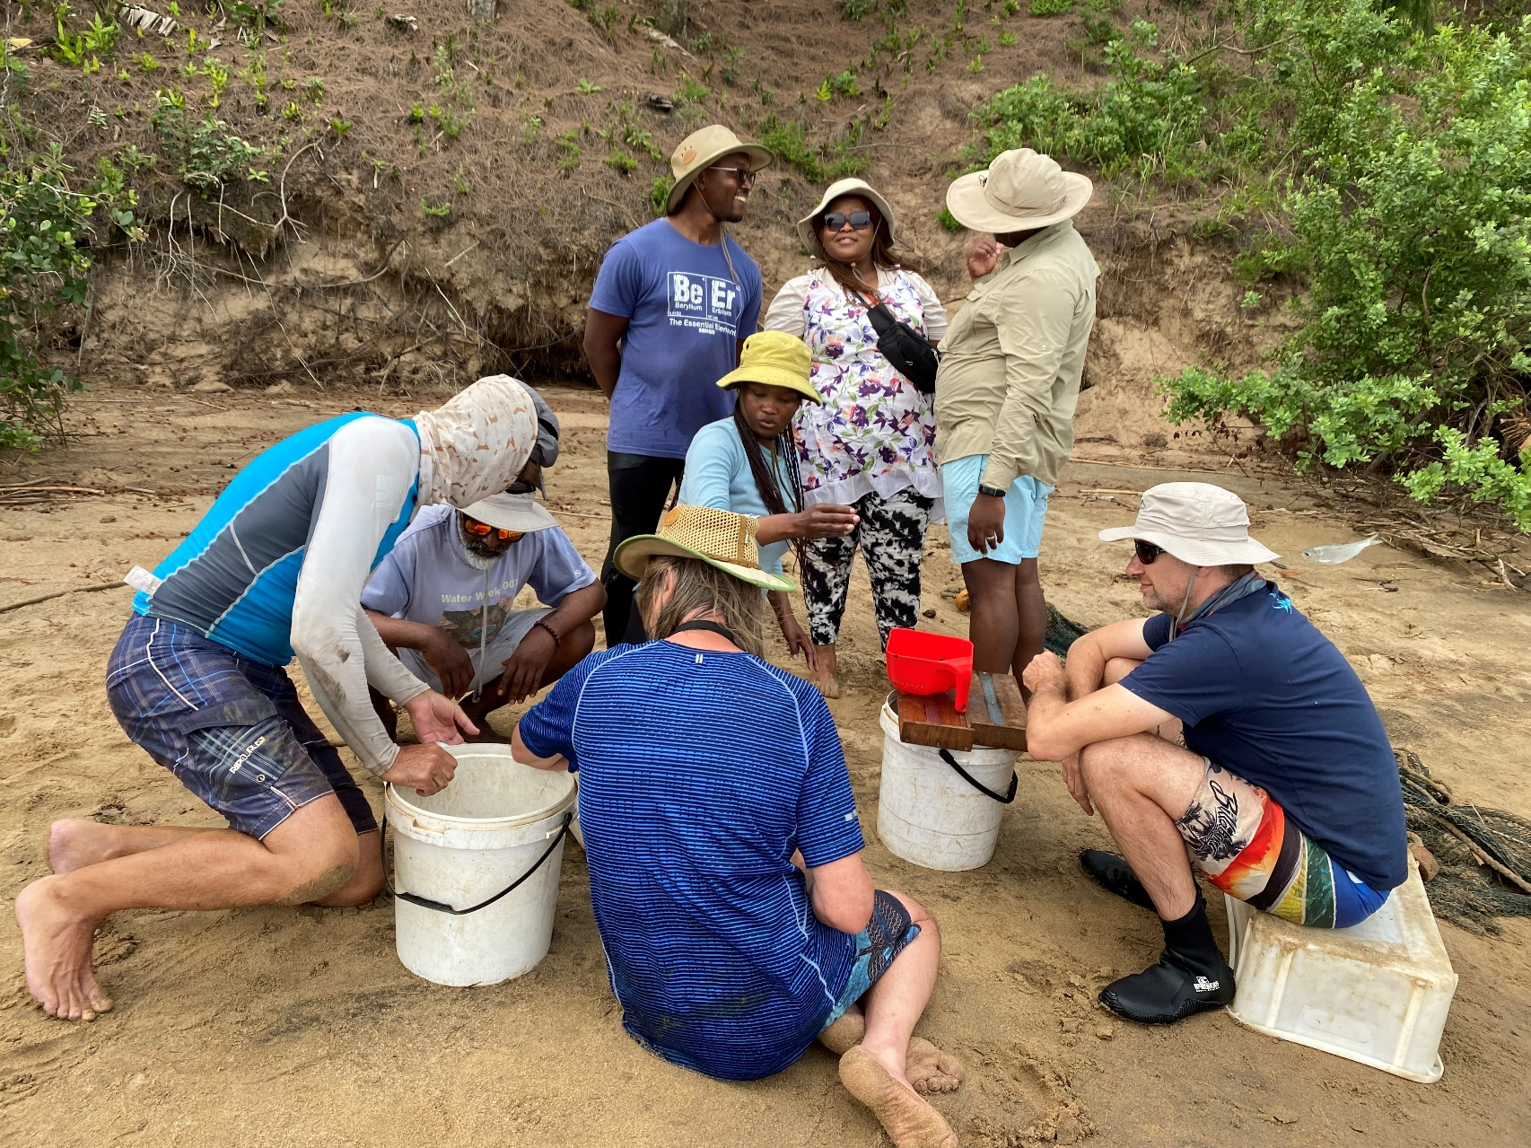
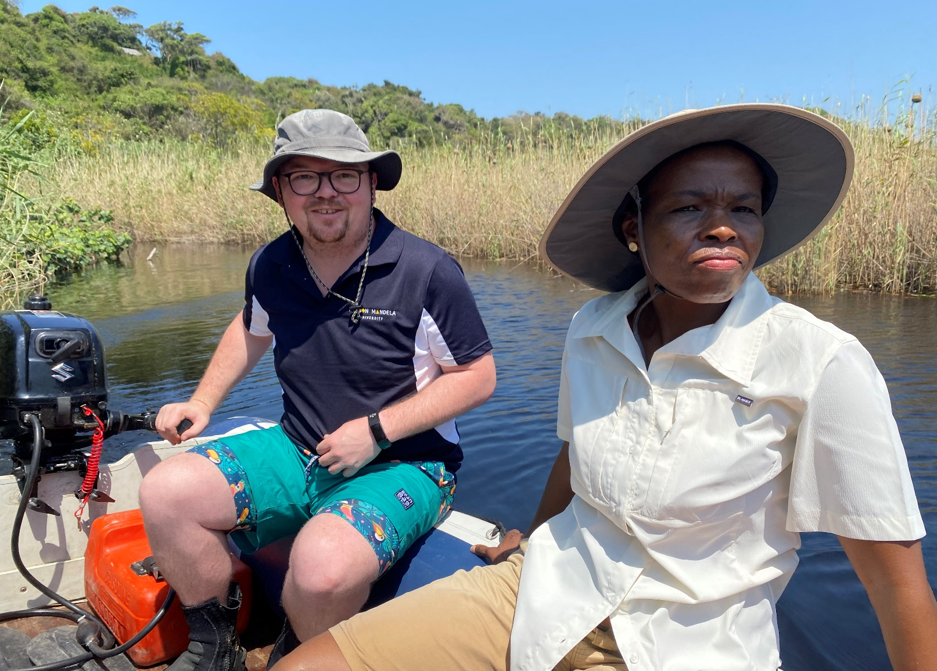
Thank you for assistance – DFFE, NMU, ORI, Ezemvelo KZN Wildlife & DWS
Notes:
DFFE, Nelson Mandela University – Carbon Team, ORI, DWS

